Slide 1
Autoencoders for Noise Reduction in Images
Russi Sinha
Vaibhav Sharma

Slide 2
Problem Statement
Colossal amounts of images captured on camera devices
More noisier than DSLR counterparts due to hardware limitations
Many solutions available to reduce noise in images
Autoencoders is an artificial neural network solution for noise removal
We take the approach in the IEEE paper “Denoising Auto-Encoder Based Image Enhancement For High Resolution Sonar Image”

Slide 3
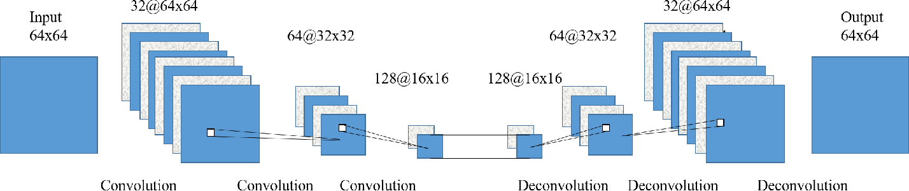
Proposed Solution
Autoencoders
Made of 2 components:
Encoder component (uses convolving layers)
Decoder component (uses deconvolving layers)
The model learns from noisy and ground truth images of the same scene

Slide 4
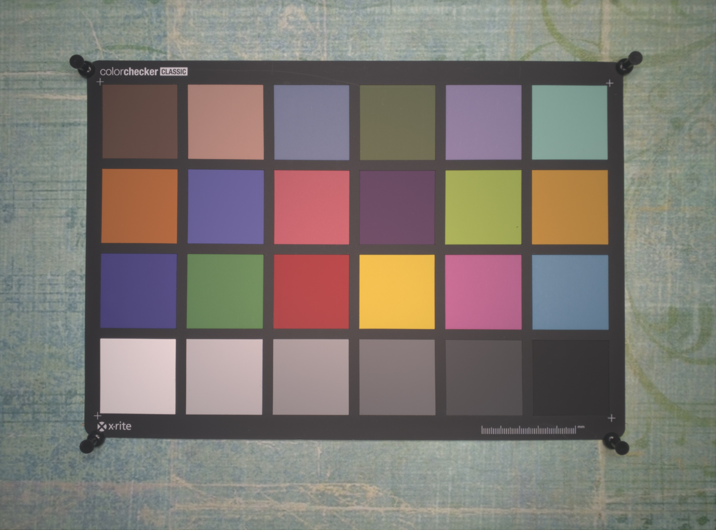

Data
Source: Smartphone Image Denoising Dataset (SIDD)
Captures static indoor scenes from different phones
Gaussian noise is added to ground truth images for learning purposes
Corresponding Ground Truth and Noisy images shown above

Slide 5
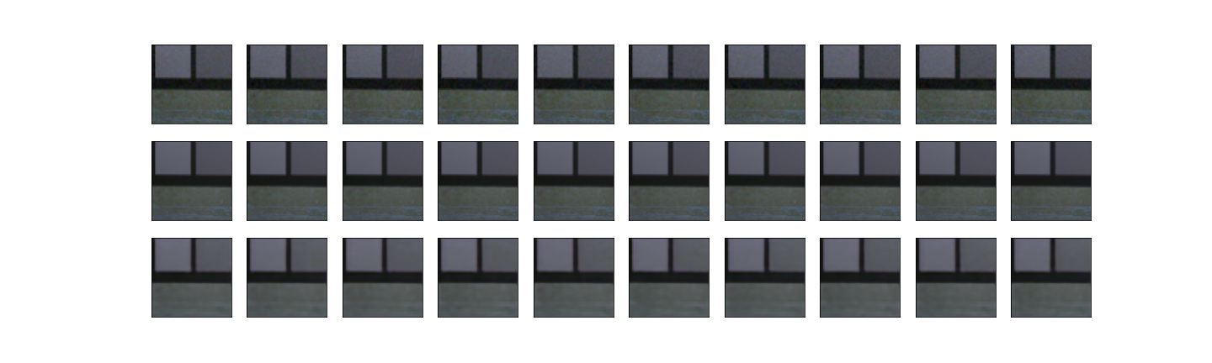
Implementation
Preprocess images to generate train and test set
Build model and train for different Loss functions and Optimizers
Check output against the noisy and ground truth images

Slide 6
Implementation – Image Preprocessing
The original image is resized to 192x342
The resized images are cropped to 64x64
Each image gives out 12 cropped images
Generates 9000 cropped images from 600 original images
Overall dataset is divided into 80:20 as train:test split

Slide 7
Implementation – Model Training
The autoencoder is trained for 25 epochs
Autoencoders need an optimizer and loss function which were chosen by iterative training and evaluation of model using different combinations of each
Best combination for this problem:
Optimizer = adadelta
Loss Function = mean squared error

Slide 8
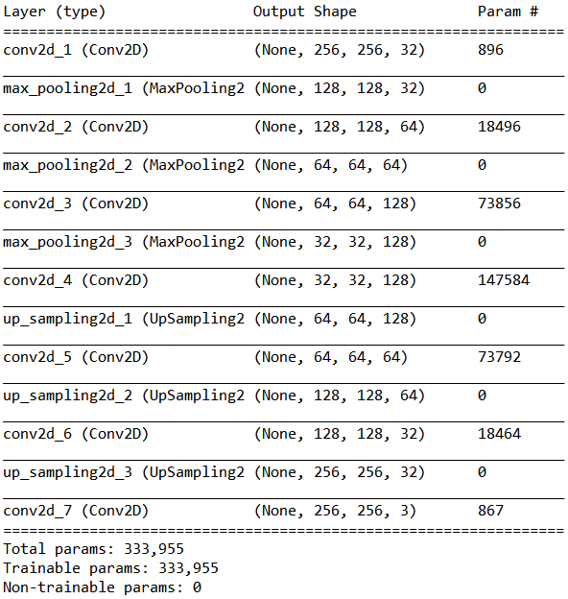
Model Structure
This Denoising Autoencoders follows the given architecture
conv2d_1, conv2d_2 and conv2d_3 form encoder
conv2d_4, conv2d_5 and conv2d_6 form decoder

Slide 9
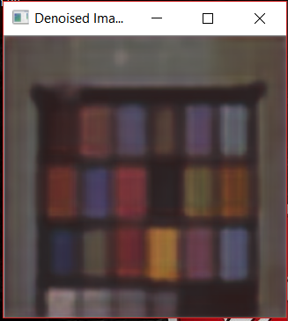
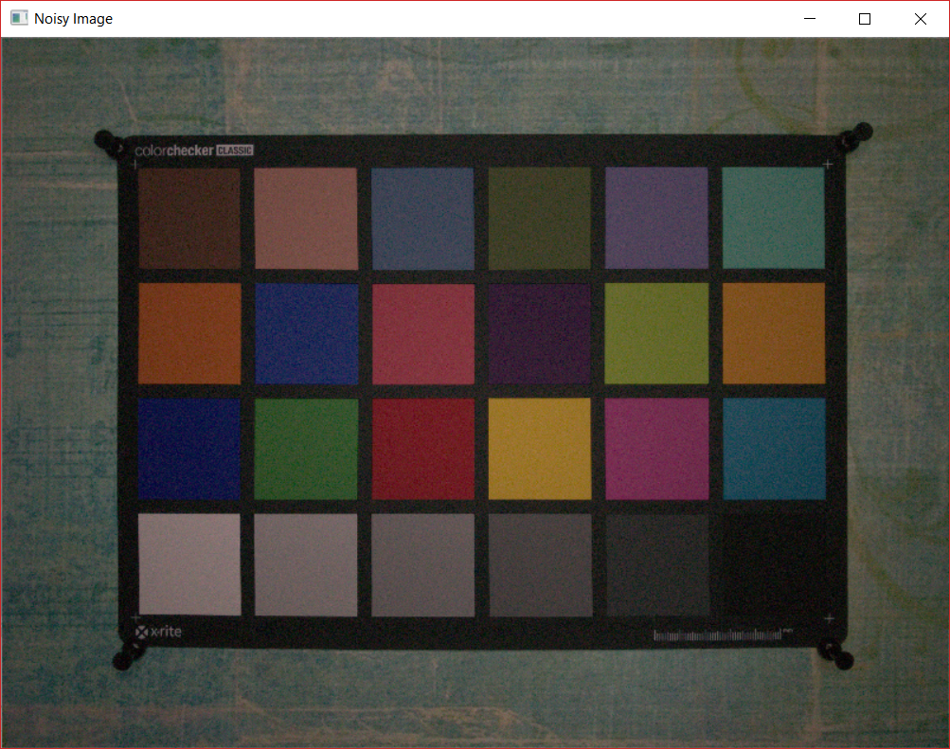
Results
The autoencoder with adadelta optimizer and mean squared error loss function yielded the best results for the cropped image dataset generated
The loss on validation set is 2.9321e-04 with the following images generated from testing the model

Slide 10
Conclusion
As seen in the Results section, the images generated by the autoencoder are blurry but smoothed
Smoothed images indicate noise removal
Confirm that Neural networks can implement noise removal with efficiency

